Slide 1
Week 5 Updates: SolidWorks DFM Plug-In
Ruoyu Song
Dr. Cassandra Telenko
Aniruddh Marellapudi

Slide 2
Updates from Week 4
Added UI for user to input design tolerances for features
Need to add support for user to add additional tolerances
Improved sidebar UI (new design and new sections)
Started interfacing with SculptPrint
Can run automated Python script from C#
Need to test automated script to fixture part and calculate tool paths

Slide 3
Next Steps
Complete and test interface with SculptPrint
Install plug-in, SculptPrint, and Python on a computer and try to run the whole program
Run C# SolidWorks plug-in -> run Python SculptPrint script -> take image/screenshot of toolpath and final volume -> display in SolidWorks
Keep documenting everything
Make guide for tutorial part

Slide 4
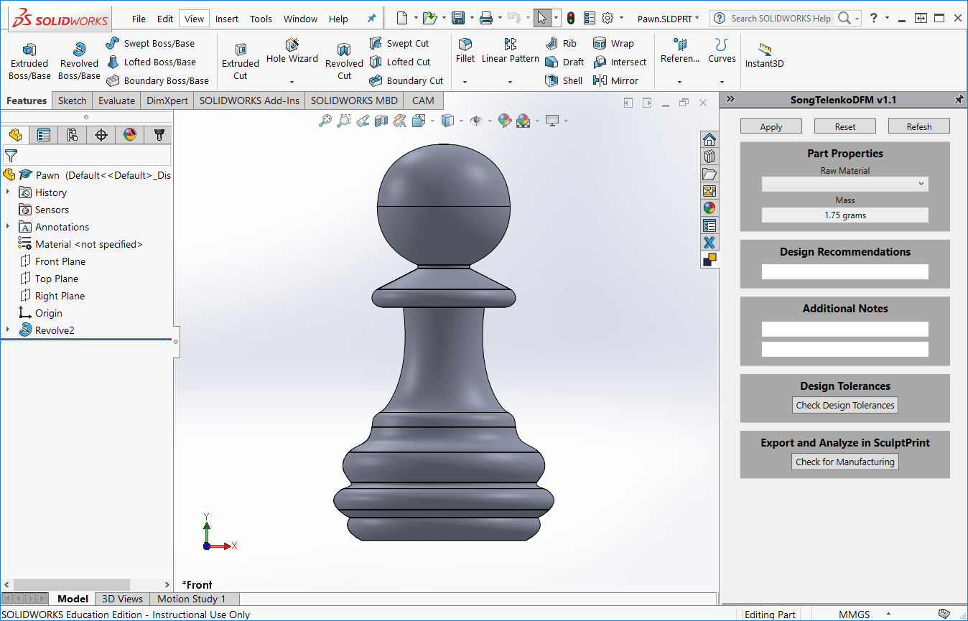

Slide 5
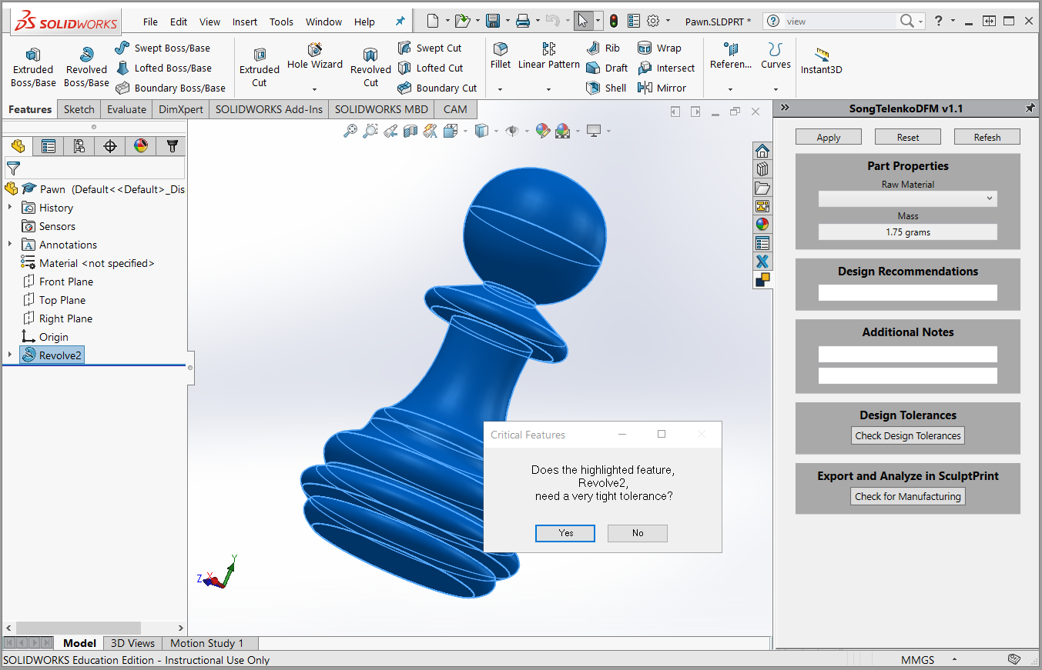

Slide 6
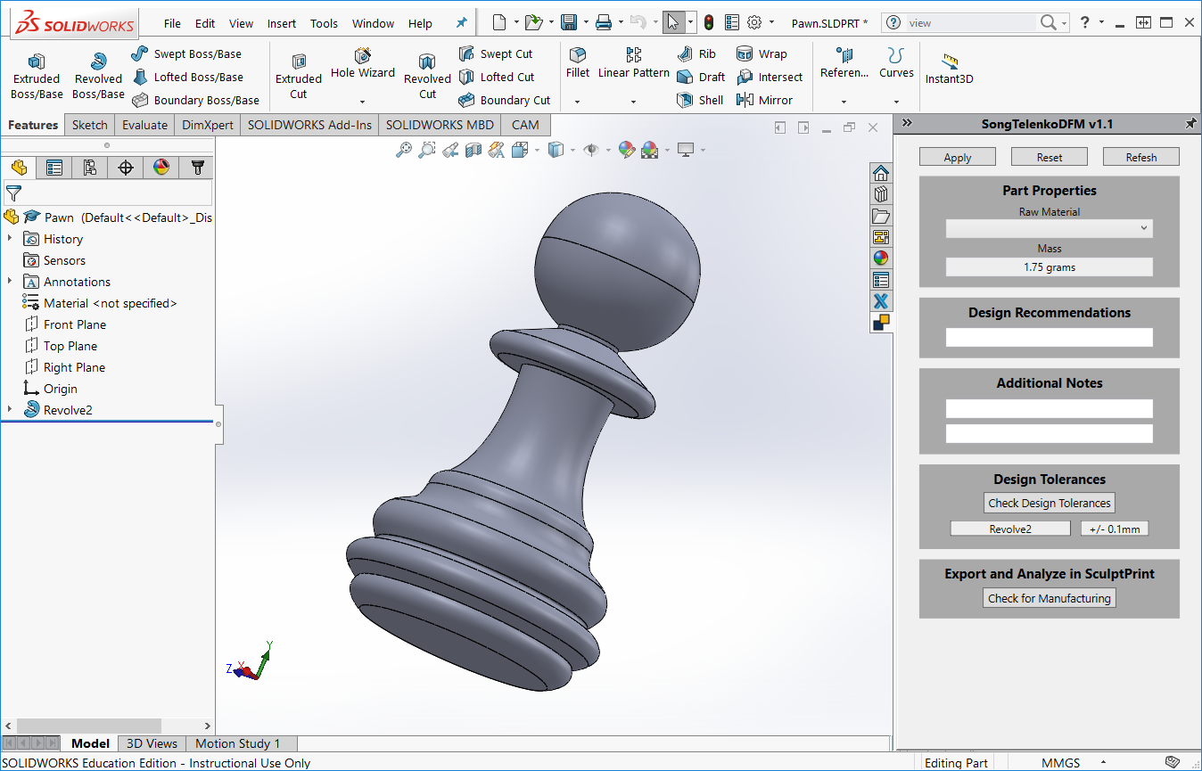

Slide 7
Project Decisions
Need a proper name and description to display in SolidWorks
Need to determine ideal instructions for message-box prompts

Slide 8
Problems List and Solution
AngelSix Add-In Installer returns with an error
The add-in installer runs RegAsm.exe to register your plug-in’s .dll
Can debug manually
cd C:\Windows\Microsoft.NET\Framework64\v4.0.30319
RegAsm.exe /codebase "C:\Users\Aniruddh\Desktop\solidworks-api-develop\Tutorials\DynamicReload\DynamicReload\bin\Debug\DynamicReload.dll"

Slide 9
Problems List and Solution (Cont’d)
Packages downloaded from GitHub do not compile because Dna.Framework is not a valid namespace
Dna.Framework, also written by AngelSix, is a NuGet package
NuGet is a free, open-source package manager in Visual Studio
Make sure this package is properly installed (with dependencies) for each solution

Slide 10
Problems List and Solution (Cont’d)
Make sure SolidWorks Interop files (SolidWorks Native API) have the same version as those referenced by AngelSix API
AngelSix API uses .NET Framework 4.7.1, so make sure this is consistent with your solution

Slide 11
Problems List and Solution (Cont’d)
Installing add-in shows too many Command Manager Items
Renaming the project when you have a Command Manager Item plug-in causes this
Have not found the fix so far
Possible walk-around: clone the project, and export a new .dll

Slide 12
Problems List and Solution (Cont’d)
SculptPrint Best Practices
Orient part with respect to the standard origin in CAD (SolidWorks)
Then when exporting as .STL, click options, and check “Do not translate STL output data to positive space”
Fixturing the part in SculptPrint now becomes very easy, as the coordinates defined in CAD should exactly transfer over to SculptPrint

Slide 13
Problems List and Solution (Cont’d)
NuGet SolidDna package was installed but the blue NuGet package icon is not showing up under project references
Try reinstalling, then close Visual Studio, then open Visual Studio

